Slide 1
Project Ligtas sakay mobile application
Dizon, dan Patrick r.
Maraya, lorin
Pilares, Dwight Stephen paolo C.
Pintado, vic Arthur g.

Slide 2
project description:
Ligtas Sakay Mobile Application is a safety commuting application which can help passengers to immediately report abusive PUV Drivers they may encounter. Summary features of the application includes QR Code Scanner - Scan QR Code of PUV and automatically shows information of the vehicle as well as driver's information and send it to assigned contact, Track users' location, Report Button and Danger Button.

Slide 3
General objectives:
To make a system that will give benefits to commuters and to provide security whenever they travel

Slide 4
specific objectives:
To encourage passengers to report abusive PUV Drivers
To encourage passengers to report violations they have encountered
To motivate commuters to take a part in making travel experience safe and efficient.

Slide 5
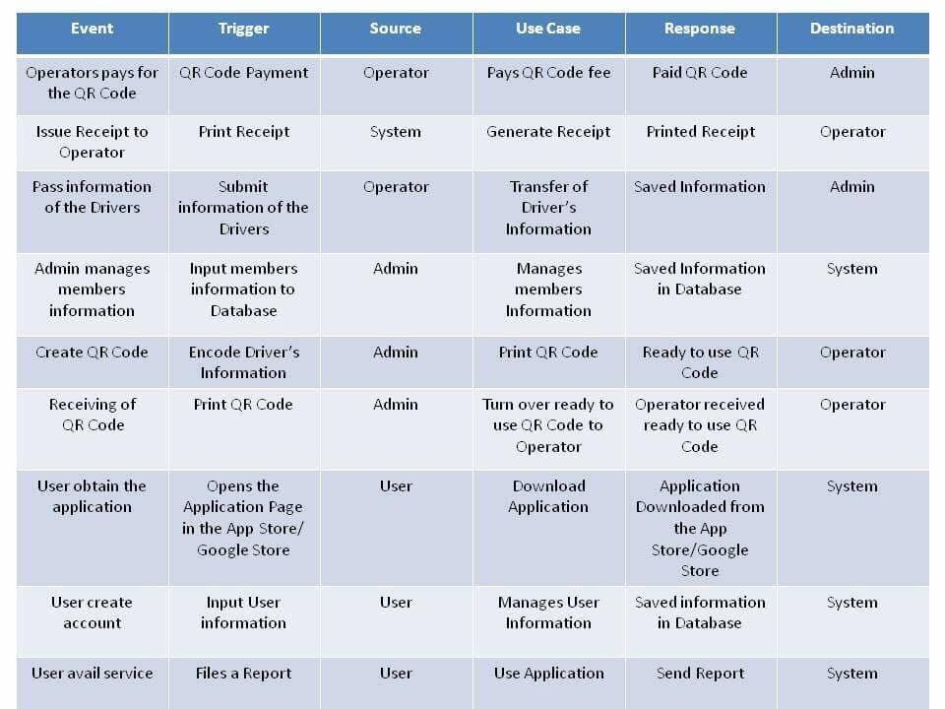
Event table

Slide 6
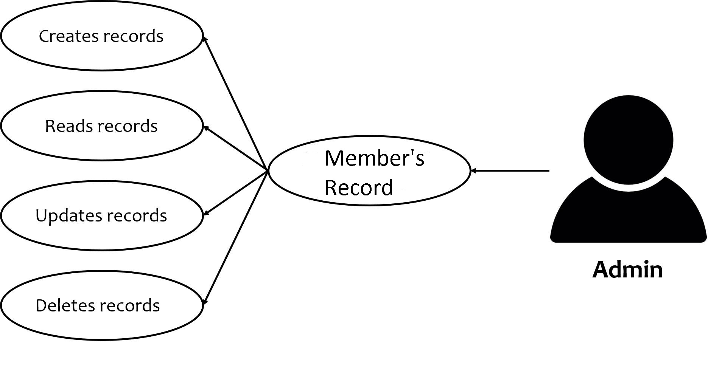
Use case: admin

Slide 7
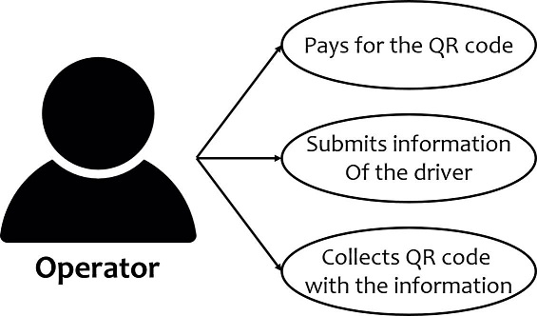
Use case: operator

Slide 8
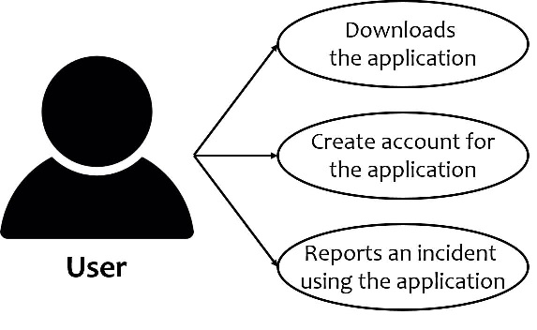
Use case: user

Slide 9
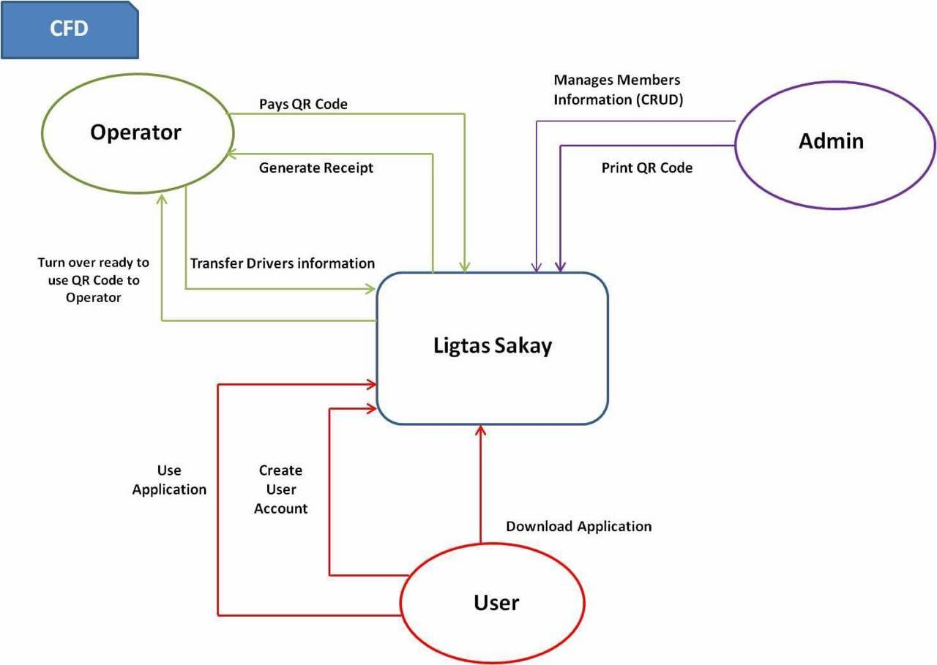
Context flow diagram:

Slide 10
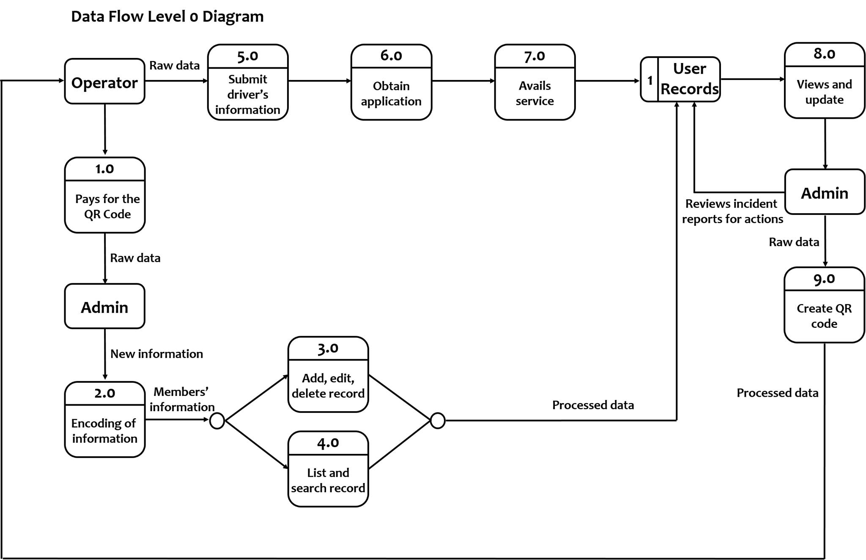
Data flow diagram level 0:

Slide 11
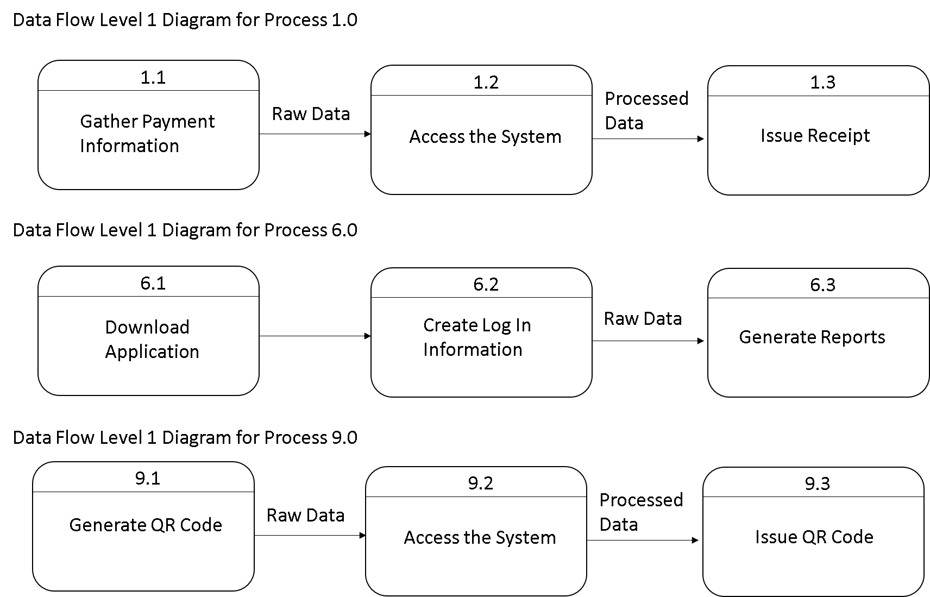
Data flow diagram level 1:

Slide 12
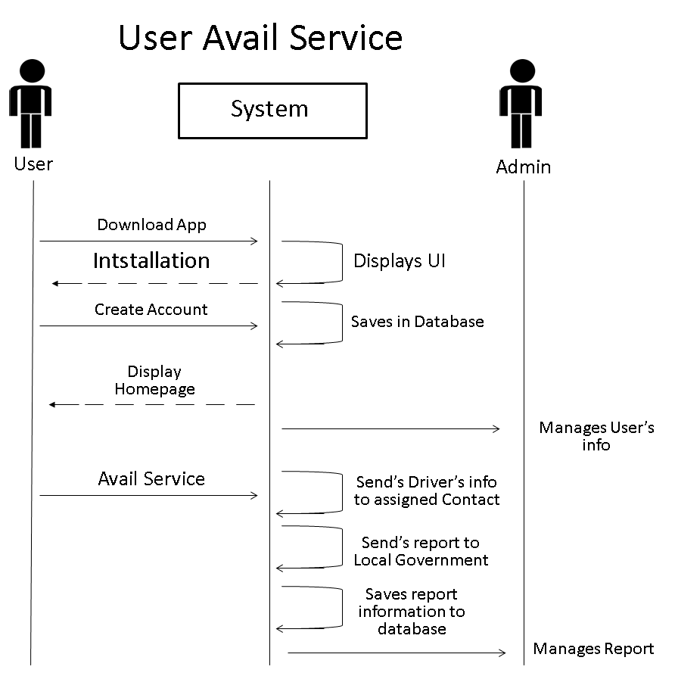
Sequence diagram:

Slide 13
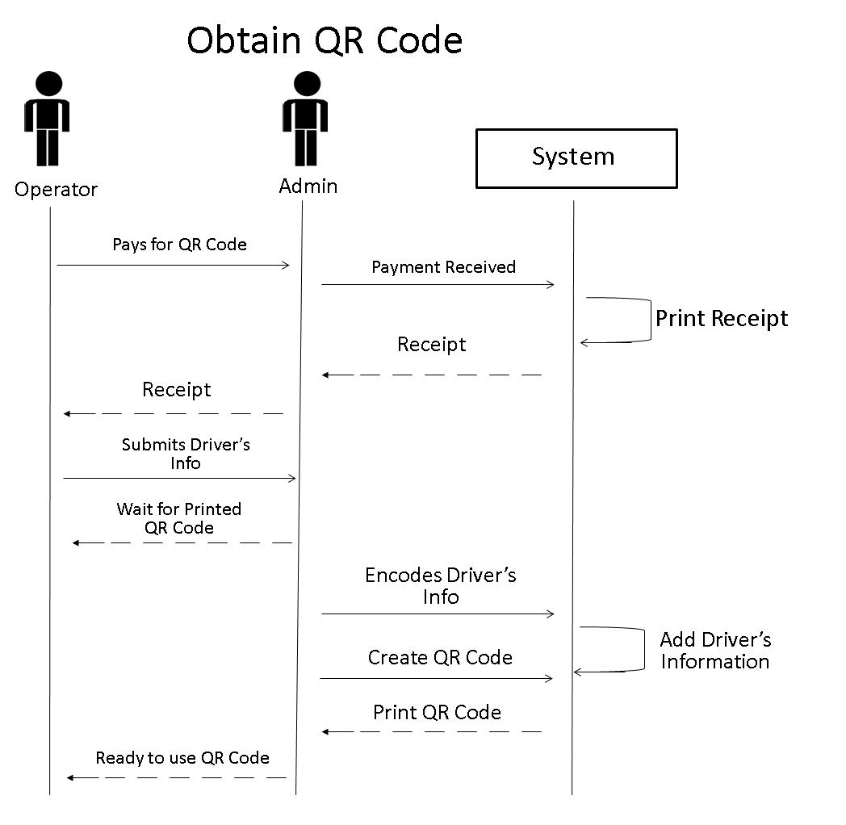
Sequence diagram:

Slide 14
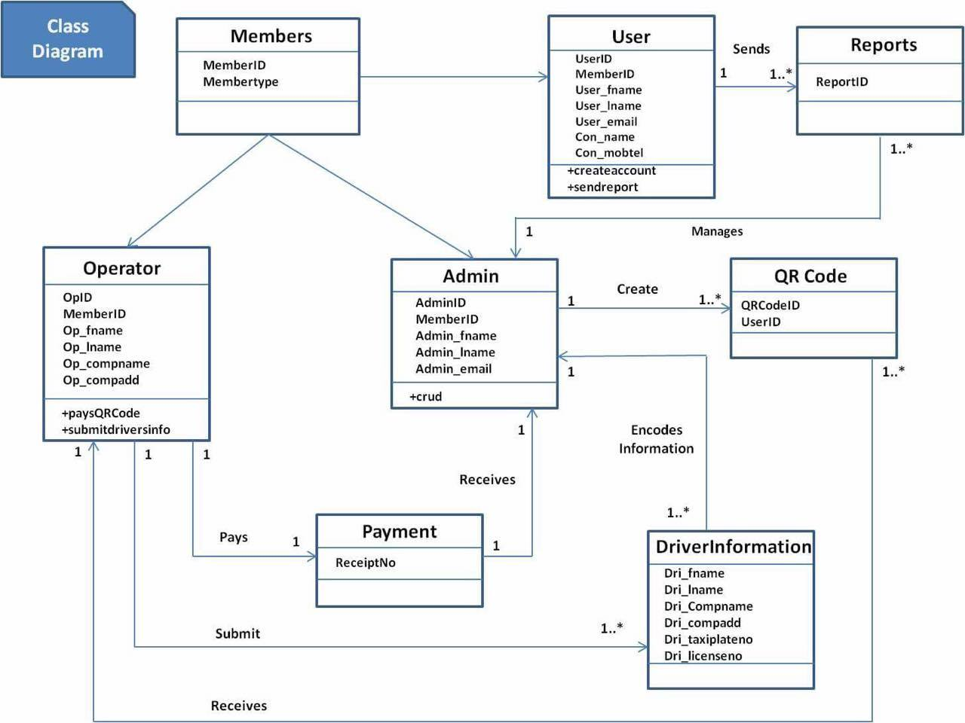
Class diagram:

Slide 15
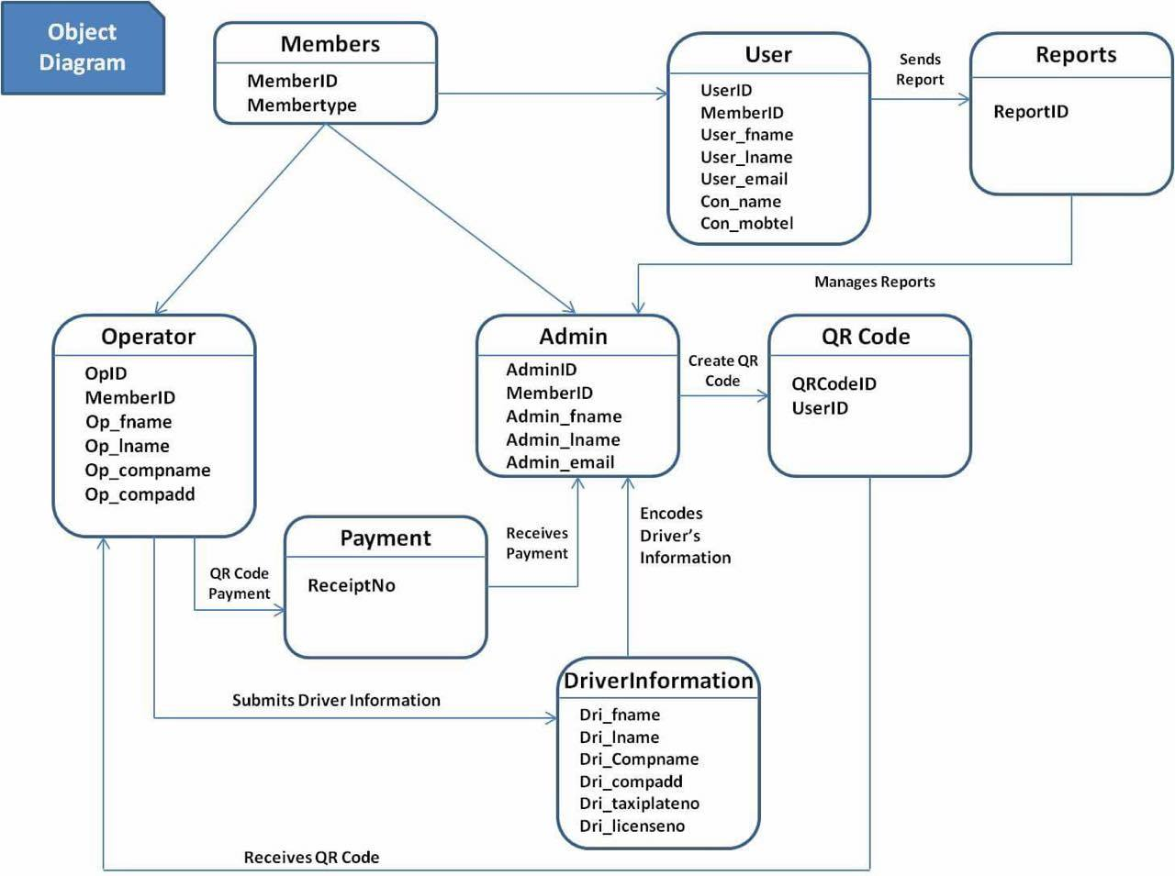
Object diagram:

Slide 16
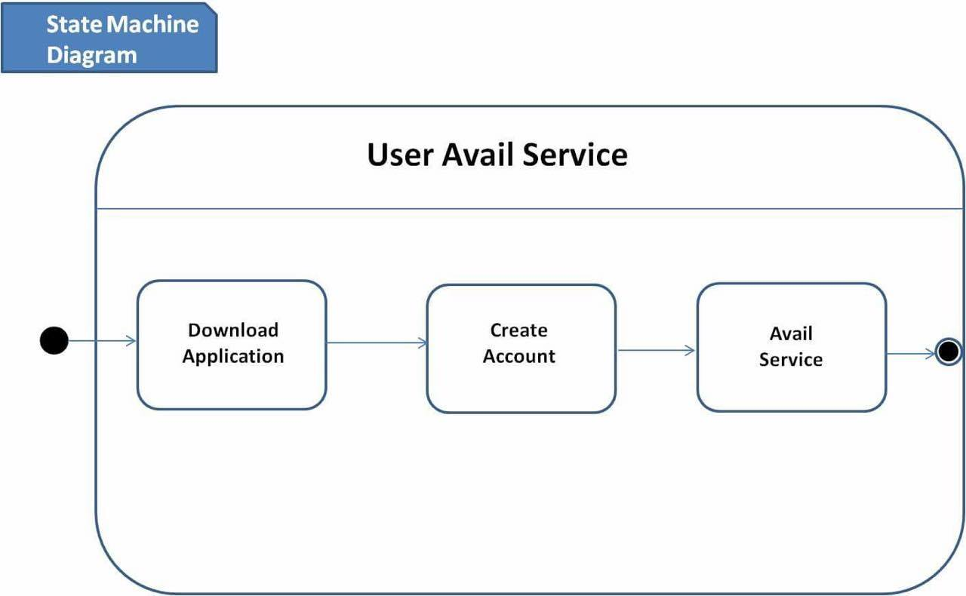
State machine diagram:

Slide 17
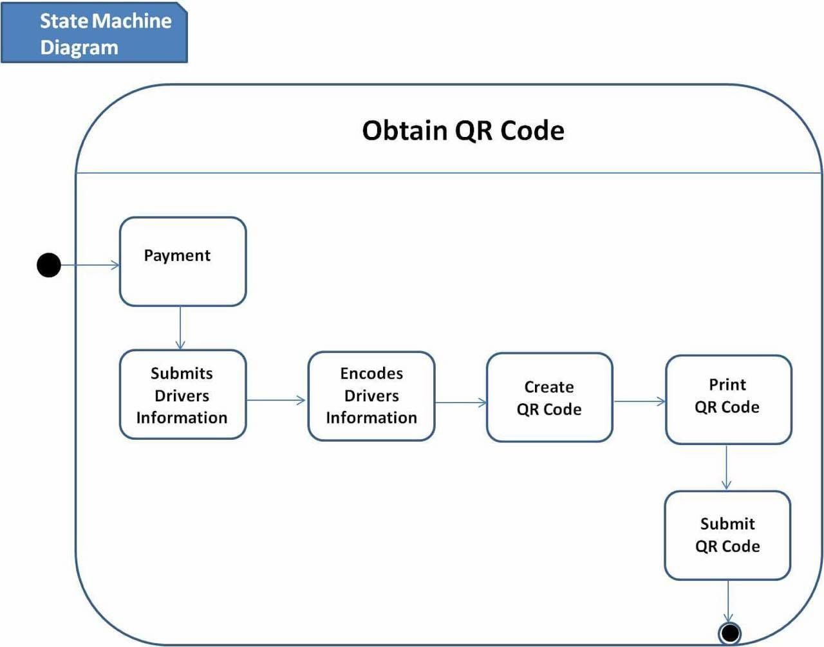
State machine diagram:

Slide 18
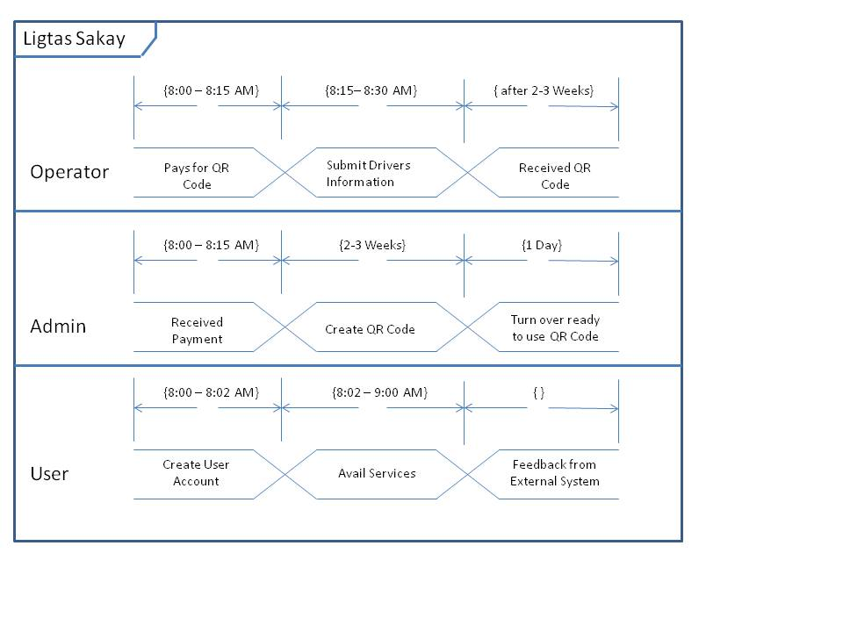
Timing diagram:

Slide 19
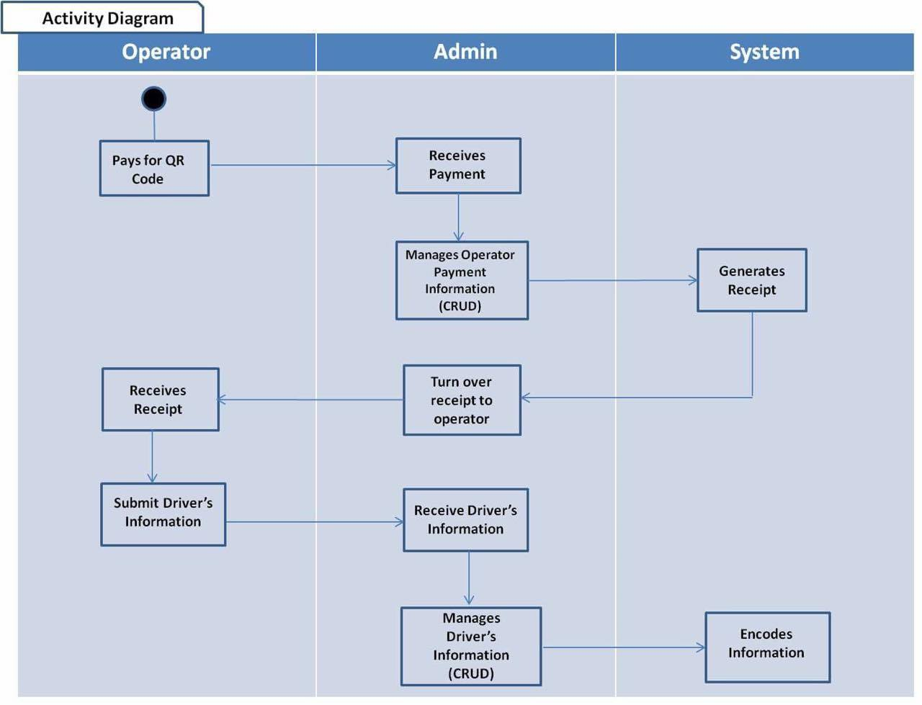
Activity diagram: user avail service

Slide 20
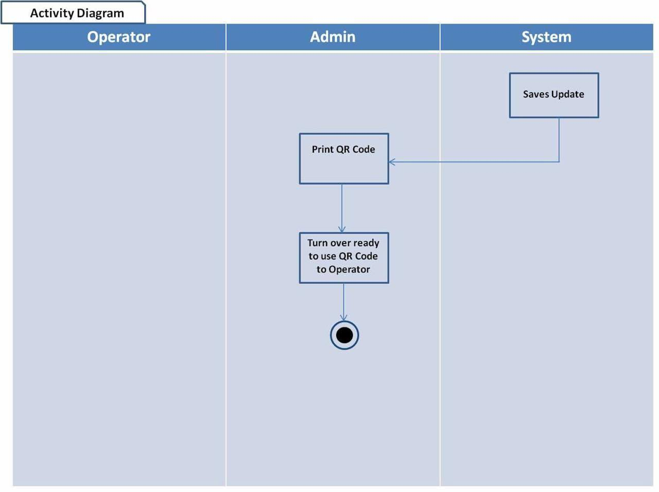
Activity diagram: obtain qr code (continuation)

Slide 21
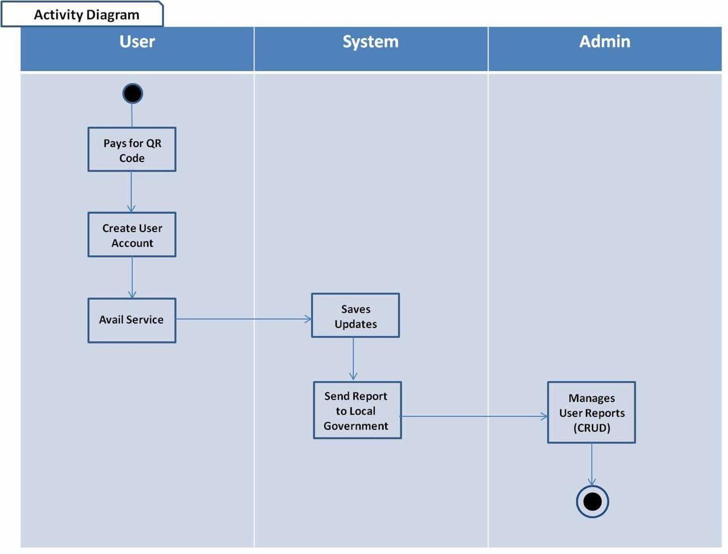
Activity diagram:

